Slide 1
Conditional Random Fields

Slide 2
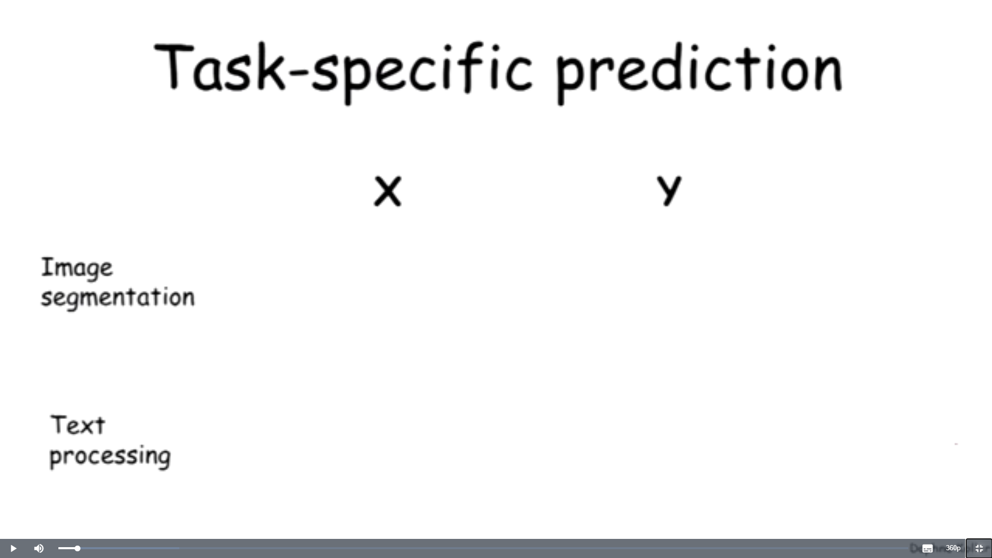
출처 : https://www.coursera.org/lecture/probabilistic-graphical-models/conditional-random-fields-UJ1Ke?redirectTo=%2Flearn%2Fprobabilistic-graphical-models%3Faction%3Denroll

Slide 3
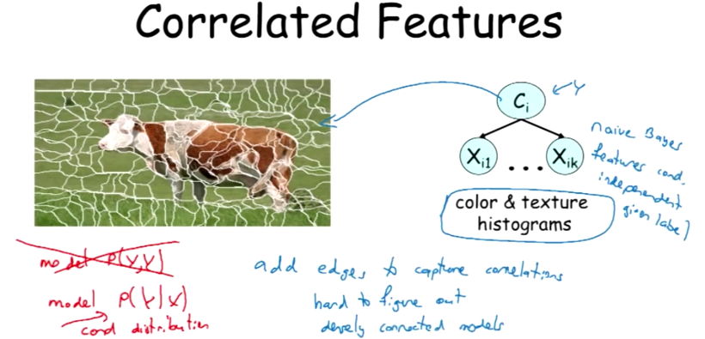

Slide 4
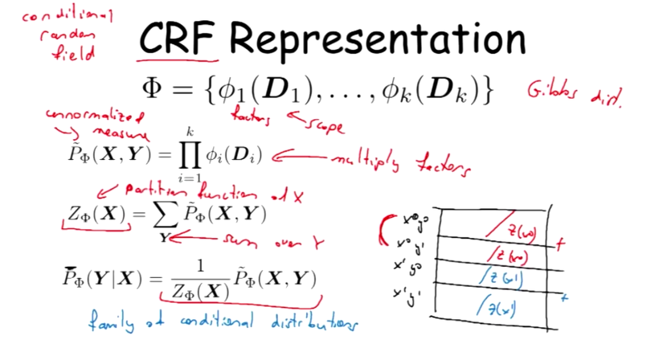

Slide 5
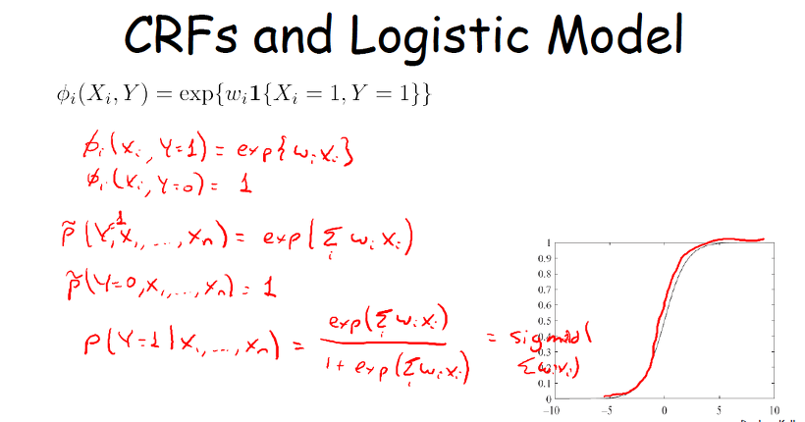

Slide 6
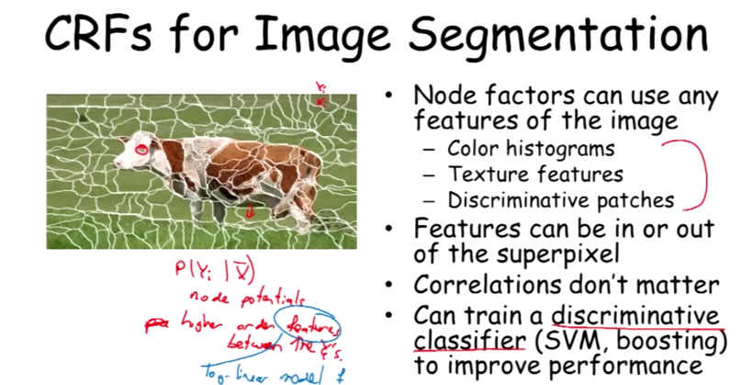

Slide 7
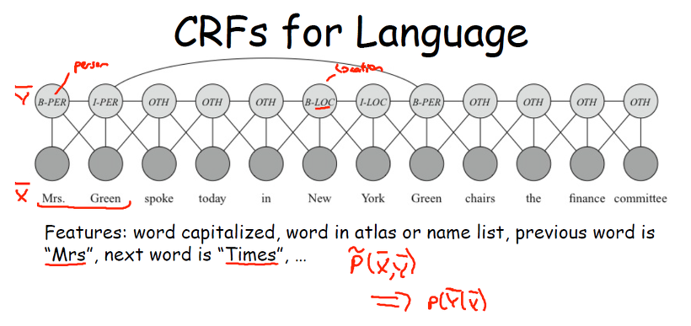

Slide 8
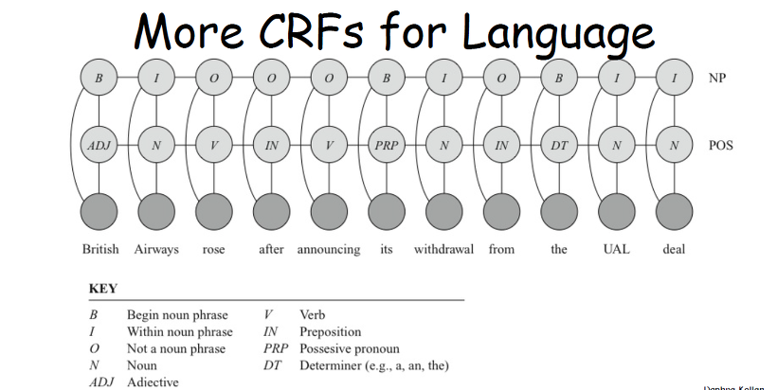

Slide 9
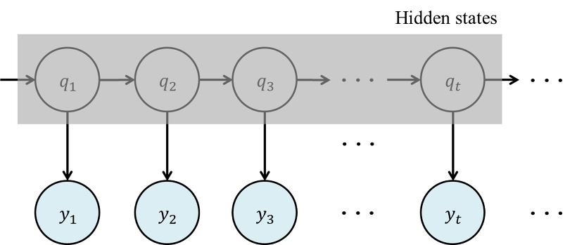
Hidden Markov model(HMM)

Slide 10
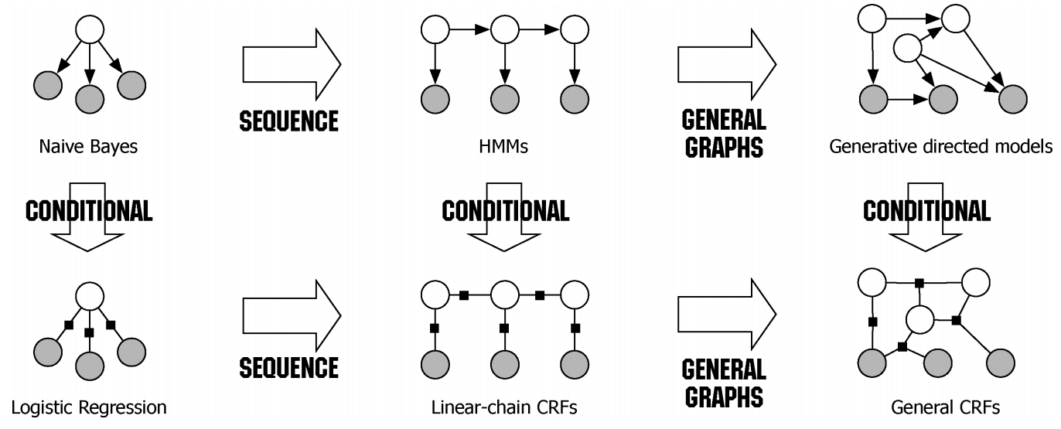

Slide 11
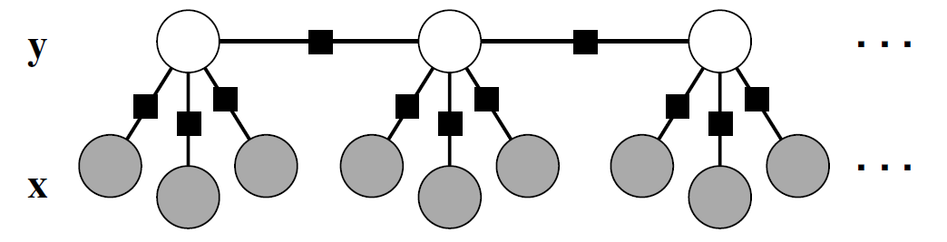

Slide 12
